Slide 1
Chapter 5.7 ADDITION OF POLYNOMIALS
Algebra concepts

Slide 2
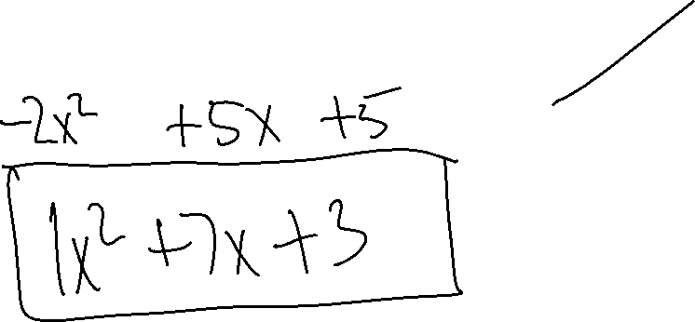
Example 1

Slide 3
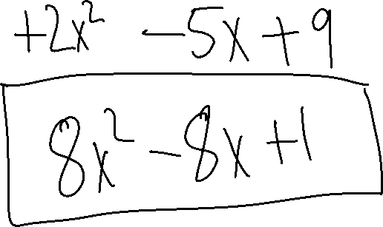
Example 2

Slide 4
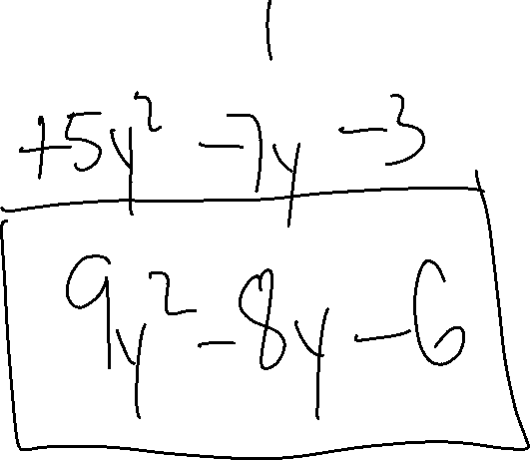
Example 3

Slide 5
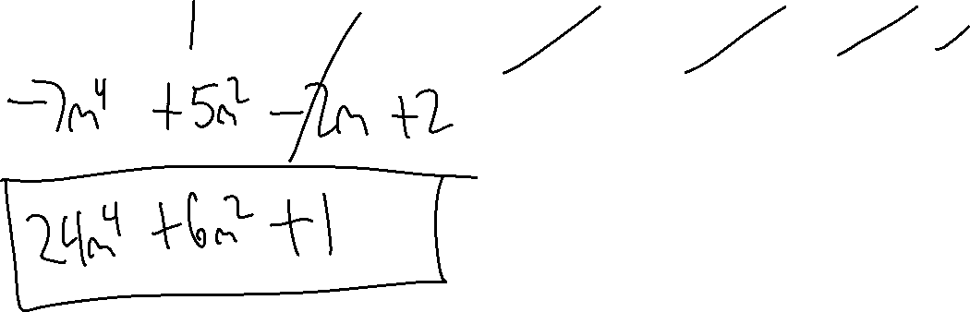
Example 4

Slide 6
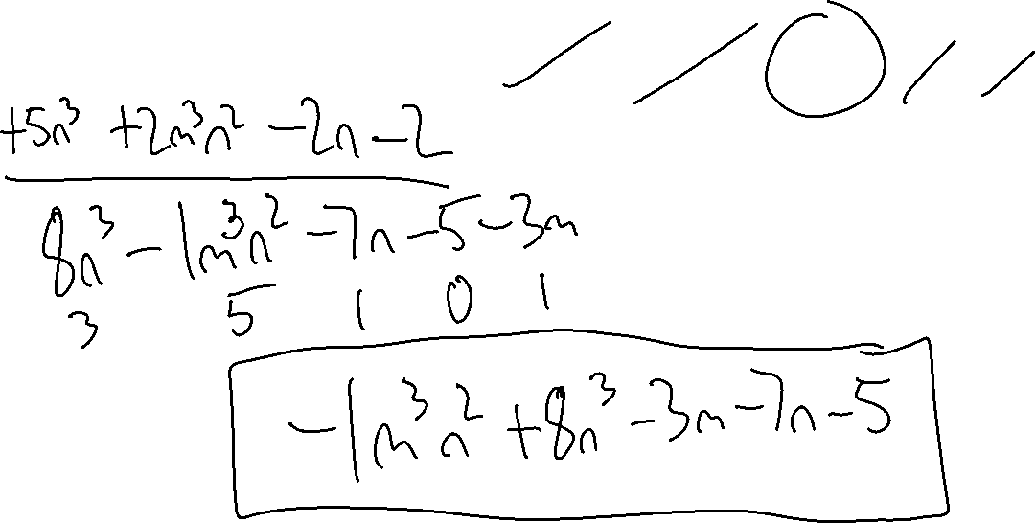
Example 5

Slide 7


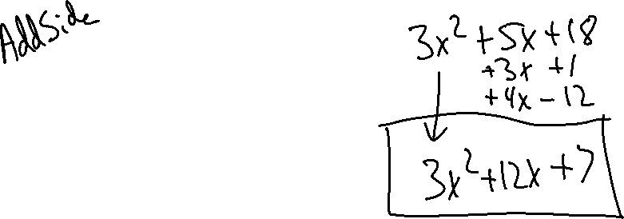

Example 6
Find the Perimeter.
$$3x+1$$
$$4x−12$$
$${3x}^{2}+5x+18$$

